Slide 1
Multiview Applications
CS235IM
iOS Application Development

Slide 2
Multiview iOS Apps
Different views are shown based on user selection.
Each view is an instance of UIView or one if its subclasses. These are called content views.
Each content view has its own instance of a subclass of UIViewController.

Slide 3
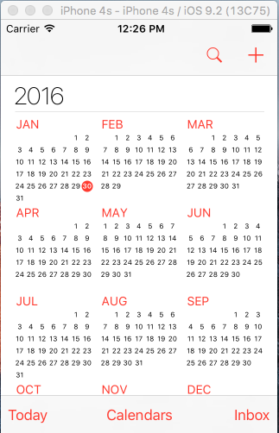
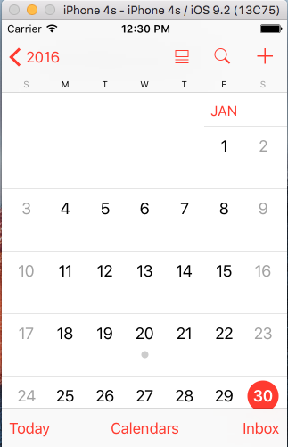
Example of a Multiview App
Notes:
Two views of the iOS calendar app (this app has more than two views).

Slide 4
Single-view Apps (Review)
When you create a single-view app, the storyboard contains an instance of a UIView subclass and a UIViewControler subclass by default.
The view contains instances of UIView subclsses like: UIControl (with subclasses like UIButton, UISlider, UITextField), UILabel, UIAlertView, etc.
iOS Developer Library: UIView class reference

Slide 5


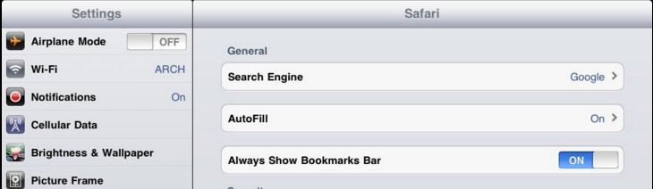
Types of Multiview Apps
Navigation bar Navigation Controllers
Tab bar Tab Bar Controllers
Split view (for iPad) Split View Controllers
Notes:
Examples using the iOS News app and the

Slide 6
Navigation Controllers
UINavigationController – used with UINavigationBar and (optionally) a toolbar.
UITabBarController – used with a tab bar
UIPageViewController – used to create a book style navigation experience
UISplitViewController – used on the iPad only. Provides selection options on the left and content on the right.
Notes:
These are the navigation controller classes available in iOS

